Slide 1


Basic Details of the Team and Problem Statement
Idea & Approach Details
Problem Statement Title: ADHD students experiencing challenges in academic settings due to difficulties in attention, organization, and impulse control.
Team Name: CapsLock
Team Leader Name: Swayam Khanduri
Track Name: Education

Slide 2



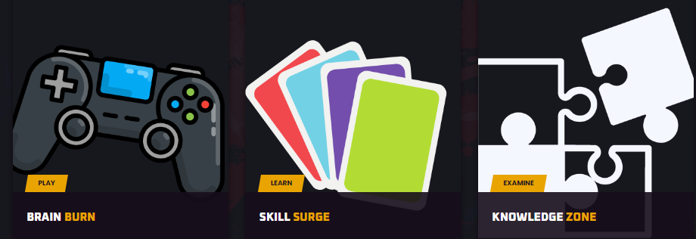
Idea & Approach Details
Description of idea/Solution/Prototype:
We seek a solution for ADHD, a condition worsened by decreasing attention spans influenced by social media, which can lead to severe future Mental Health Challenges.
Revolutionizing education through SNIPPETIZE : Offering children bit-sized, digestible snippets of knowledge, fostering engagement and overcoming short attention span through gamification.
Incentivizing students with in game currency to avail assets from market place to enhance their gaming avatar.

Slide 3
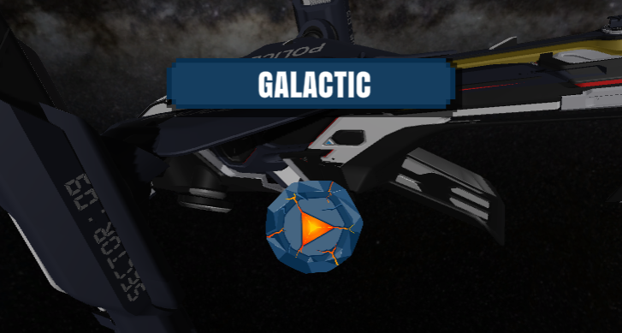
Idea & Approach Details
Description of use cases:
Register: Simply sign up on SNIPPETIZE by providing necessary details on the platform.
Engage: Participate in snippets educational sessions presented through various interactive games.
Provide Feedback: Offer feedback, enabling continuous improvement for both students and parents.
Participate: Join contests and earn game currency, incentivizing active learning.

Slide 4


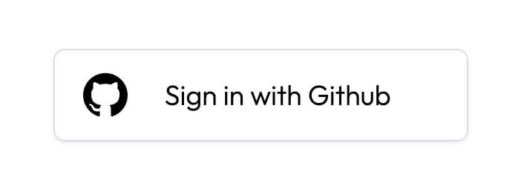
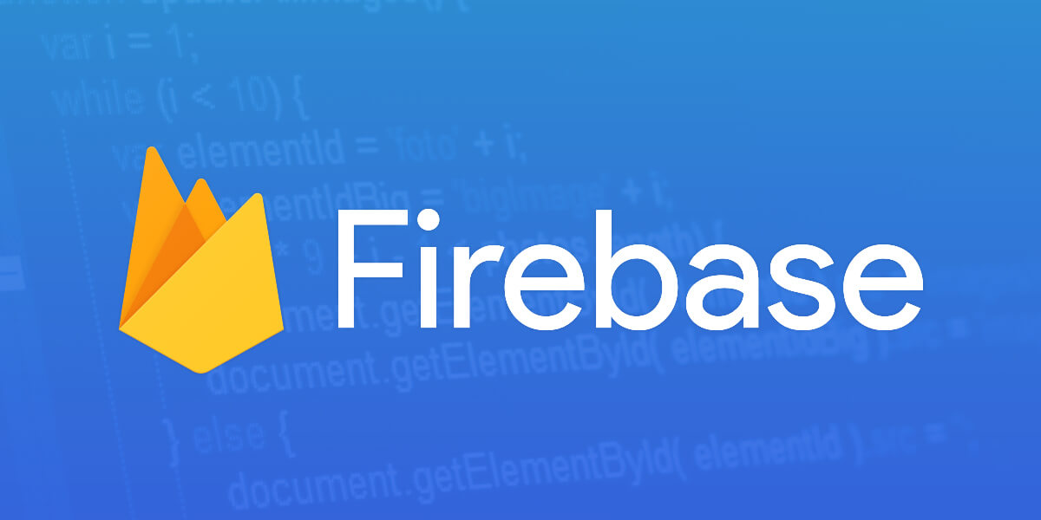
Description of Dependencies / Show stopper:
Understanding ADHD’s educational challenges with the help of doctors and teachers and analyzing the study pattern of these children.
Gather data from students playing games to observe patterns in ADHD students’ behavior, aiding future medical studies.
Automatic generation of rewards of game currency through Machine Learning and artificial intelligence.
Sensory stimulation that leverages visual, auditory and kinesthetic feedback to keep track of children with hyperactivity.
GAMES CAN BE AN EFFECTIVE WAY TO TREAT IT

Slide 5
Technology stack:
Frontend: HTML, CSS, JavaScript
Backend: Firebase,Auth0
Hosting: Azure Cloud Services
Version Control: Git, GitHub
Tools and Frameworks: .net framework, utility game engine( C# language)

